Slide 1
Menulog Database
HD Assignment
Spring 2015
Audwin Oyong

Slide 2
Menulog Database
This database was inspired by Menulog website: www.menulog.com.au
Menulog is a website that offers online food ordering and takeaway.
It allows users to browse and order takeaway food online from various restaurants to be delivered to their home address.
This database contains details about participating restaurants, menus, orders and customer details.
It also records review information of the restaurants.

Slide 3
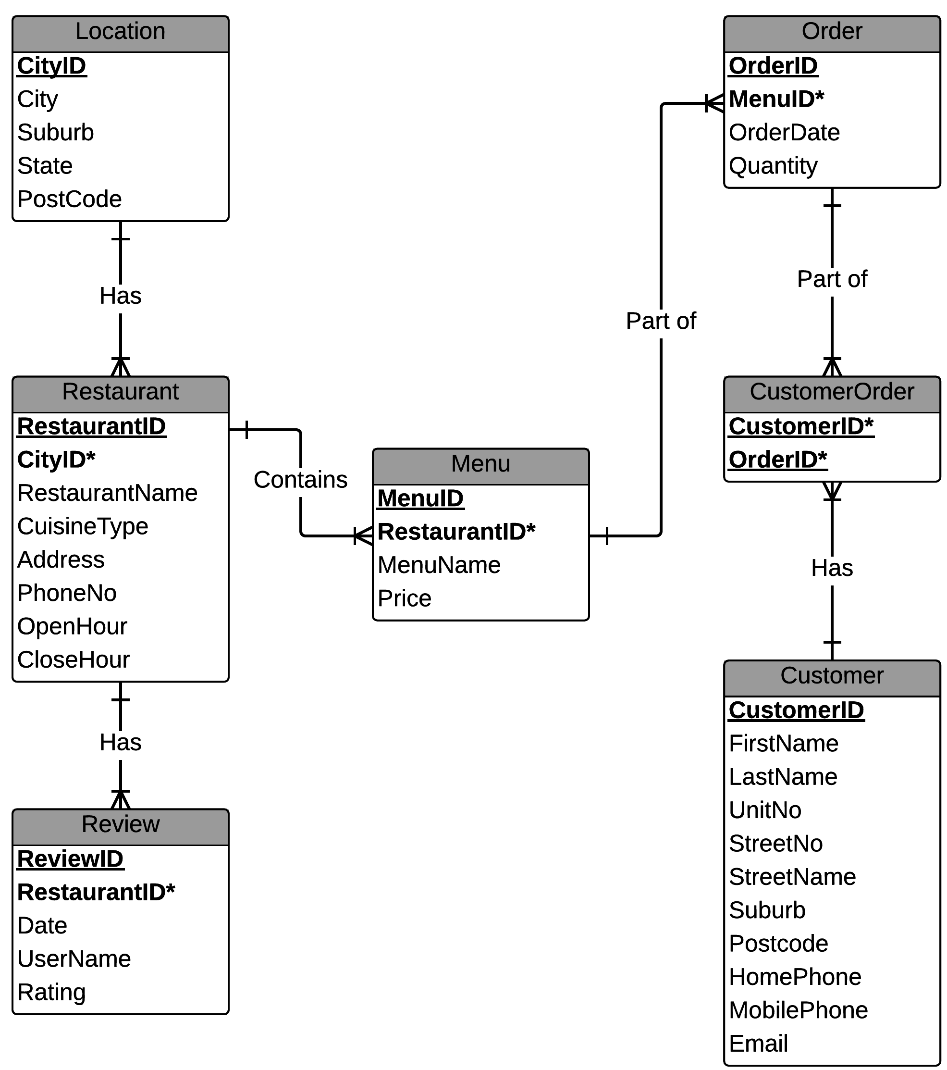
Entity Relationship Diagram (ERD)

Slide 4
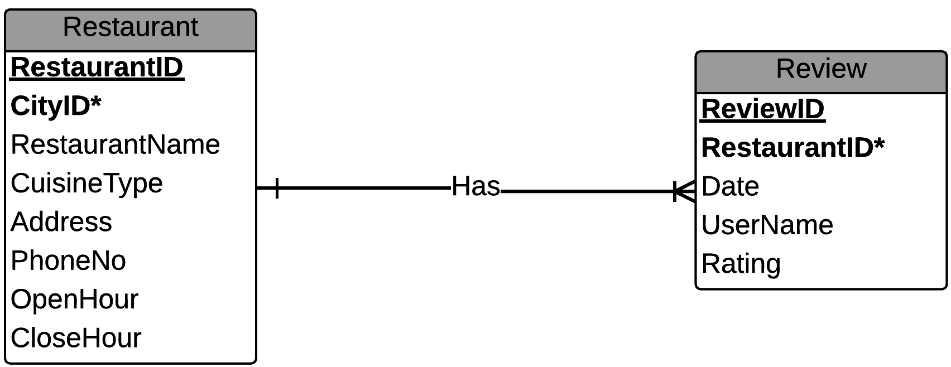
One-to-Many Relationship
One restaurant has many reviews.
(Primary Key)
Restaurant
restaurantid | cityid*| restaurantname | cuisinetype | other columns...
--------------+--------+---------------------------+-------------+------------------
4300 | 101 | The Darling Pizzeria | Italian | ...
4301 | 102 | Gourmet Curry Hut | Indian | ...
4302 | 103 | Emperor Palace Restaurant | Chinese | ...
4303 | 104 | Valentinos | Italian | ...
4304 | 105 | Chili Jam Thai | Thai | ...
(...truncated...)
(Foreign Key)
Review
reviewid | restaurantid*| date | username | rating
----------+--------------+------------+-----------+--------
56405 | 4300 | 2015-10-01 | Anonymous | 4.5
56406 | 4300 | 2015-10-02 | Greg | 3
56407 | 4300 | 2015-10-03 | Sylvia | 3.5
56408 | 4301 | 2015-10-03 | Ahmad | 4.7
56409 | 4301 | 2015-10-03 | Abdul | 3.8
56410 | 4302 | 2015-10-04 | Lee | 2.5
56411 | 4303 | 2015-10-04 | William | 4
56412 | 4304 | 2015-10-07 | Anonymous | 1.6
(...truncated...)

Slide 5
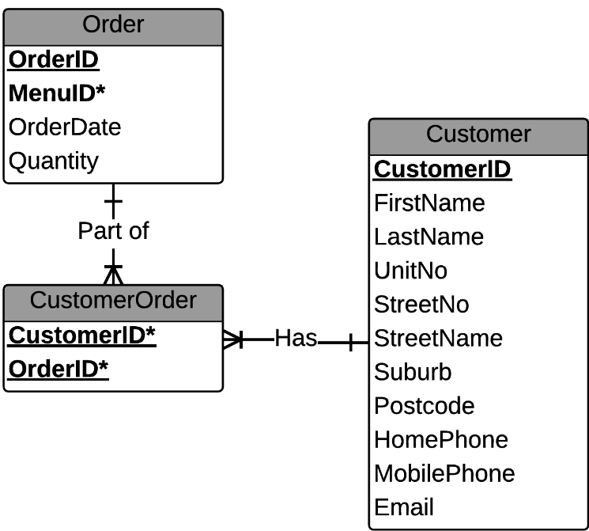
Many-to-Many Relationship
One customer can have many different orders.
One order can be part of many different customers.
(Primary Key)
Customer
customerid | firstname | lastname | unitno | streetno | streetname | suburb | postcode | other columns...
------------+-----------+----------+--------+----------+-----------------+-----------+----------+------------------
7421700 | Gary | Hickey | 65 | 272 | Harris Street | Pyrmont | 2009 | ...
7421701 | Ravi | Ahmed | 403 | 357 | Collins Street | Melbourne | 3000 | ...
7421702 | Abdul | Singh | 57 | 118 | Queen Street | Melbourne | 3000 | ...
7421703 | Sarah | Prisha | | 88 | Flinders Street | Melbourne | 3000 | ...
7421704 | Raymond | Yew | 36 | 14 | Beach Street | Frankston | 3199 | ...
7421705 | William | Wingston | 10 | 43 | Henry Street | Penrith | 2750 | ...
7421706 | Sam | Wood | 17 | 166 | Station Street | Penrith | 2750 | ...
(...truncated...)
(Foreign Key)
CustomerOrder
(Foreign Key)
(Primary Key)
Order
customerid*| orderid*
------------+---------
7421700 | 681500
7421700 | 681501
7421701 | 681502
7421702 | 681502
7421703 | 681502
7421704 | 681503
7421705 | 681504
7421706 | 681505
(...truncated...)
orderid | menuid*| orderdate | quantity
---------+--------+------------+----------
681500 | 58200 | 2015-10-01 | 1
681501 | 58212 | 2015-10-01 | 3
681502 | 58203 | 2015-10-02 | 1
681503 | 58268 | 2015-10-02 | 2
681504 | 58201 | 2015-10-03 | 3
681505 | 58205 | 2015-10-07 | 2
(...truncated...)

Slide 6
Simple Query
Description:
Find all the restaurants including their address and business hours that have Italian cuisine.
SQL Query:
SELECT restaurantname, address, openhour, closehour
FROM menulog_restaurant
WHERE cuisinetype = 'Italian'
ORDER BY restaurantname;
Result:
restaurantname | address | openhour | closehour
----------------------+--------------------+----------+-----------
Ravens Eye | 127 King Street | 12:00:00 | 22:00:00
The Darling Pizzeria | 88-90 Union Street | 11:30:00 | 23:59:00
Toppinz Bar | 101 Burwood Road | 17:00:00 | 21:30:00
Valentinos | 17/55-61 York Road | 17:30:00 | 21:15:00
(4 rows)
Notes:
SELECT restaurantname, address, openhour, closehour
FROM menulog_restaurant
WHERE cuisinetype = 'Italian'
ORDER BY restaurantname;

Slide 7
Natural Join Query
Description:
List restaurant name and type of cuisine that open after 14:00 with review rating at least 4 stars.
SQL Query:
SELECT restaurantname, cuisinetype, openhour, rating
FROM menulog_restaurant NATURAL JOIN menulog_review
WHERE openhour > 14 AND rating >= 4
ORDER BY rating;
Result:
restaurantname | cuisinetype | openhour | rating
--------------------+-------------+----------+--------
Valentinos | Italian | 17:30:00 | 4
Mascot Asian House | Chinese | 16:30:00 | 4.5
Delhi 77 | Indian | 17:00:00 | 4.6
Gourmet Curry Hut | Indian | 15:00:00 | 4.7
(4 rows)
Notes:
SELECT restaurantname, cuisinetype, openhour, rating
FROM menulog_restaurant NATURAL JOIN menulog_review
WHERE openhour > 14 AND rating >= 4
ORDER BY rating;

Slide 8
Cross Product Equivalent
Description:
Using cross product notation, list restaurant name and type of cuisine that open after 14:00 with review rating at least 4 stars.
SQL Query:
SELECT restaurantname, cuisinetype, openhour, rating
FROM menulog_restaurant, menulog_review
WHERE menulog_restaurant.restaurantid = menulog_review.restaurantid
AND openhour > 14 AND rating >= 4 ORDER BY rating;
Result:
restaurantname | cuisinetype | openhour | rating
--------------------+-------------+----------+--------
Valentinos | Italian | 17:30:00 | 4
Mascot Asian House | Chinese | 16:30:00 | 4.5
Delhi 77 | Indian | 17:00:00 | 4.6
Gourmet Curry Hut | Indian | 15:00:00 | 4.7
(4 rows)
Notes:
SELECT restaurantname, cuisinetype, openhour, rating
FROM menulog_restaurant, menulog_review
WHERE menulog_restaurant.restaurantid = menulog_review.restaurantid
AND openhour > 14 AND rating >= 4 ORDER BY rating;

Slide 9
Group By / Having Query
Description:
Display all restaurants that have received reviews more than one. Order by the restaurant name.
SQL Query:
SELECT restaurantid, restaurantname, count(reviewID) AS reviews
FROM menulog_restaurant NATURAL JOIN menulog_review
GROUP BY restaurantid, restaurantname HAVING count(reviewid) > 1
ORDER BY restaurantname;
Result:
restaurantid | restaurantname | reviews
--------------+----------------------+---------
4301 | Gourmet Curry Hut | 2
4300 | The Darling Pizzeria | 3
4309 | Toppinz Bar | 4
(3 rows)
Notes:
SELECT restaurantid, restaurantname, count(reviewID) AS reviews
FROM menulog_restaurant NATURAL JOIN menulog_review
GROUP BY restaurantid, restaurantname HAVING count(reviewid) > 1
ORDER BY restaurantname;

Slide 10
Sub Query
Description:
Show the menus and prices that are more expensive than the average of all menus available.
SQL Query:
SELECT menuname, price
FROM menulog_menu
WHERE price > (SELECT AVG(price)
FROM menulog_menu);
Result:
menuname | price
-------------------+-------
Australiana Pizza | 17.5
Vegetable Korma | 14.5
Honey Chicken | 12
Bolognese Pasta | 18
Seafood Ramen | 11.5
Bombay Beef | 14.9
Chicken Omelette | 11.9
Napolitana Pizza | 15
(8 rows)
Notes:
SELECT menuname, price
FROM menulog_menu
WHERE price > (SELECT AVG(price) FROM menulog_menu);

Slide 11
Self Join
Description:
Using cross product notation, find all the customers that live in the same suburb.
SQL Query:
SELECT DISTINCT a.customerID, a.firstname, a.lastname, a.suburb
FROM menulog_customer a, menulog_customer b
WHERE a.suburb = b.suburb
AND a.firstname != b.firstname
AND a.lastname != b.lastname;
Result:
customerid | firstname | lastname | suburb
------------+-----------+----------+-----------
7421701 | Ravi | Ahmed | Melbourne
7421702 | Abdul | Singh | Melbourne
7421703 | Sarah | Prisha | Melbourne
7421705 | William | Wingston | Penrith
7421706 | Sam | Wood | Penrith
7421709 | Sher | Ali | Penrith
(6 rows)
Notes:
SELECT DISTINCT a.customerID, a.firstname, a.lastname, a.suburb
FROM menulog_customer a, menulog_customer b
WHERE a.suburb = b.suburb
AND a.firstname != b.firstname
AND a.lastname != b.lastname;

Slide 12
CHECK Constraints (1)
Checks the validity of State and Postcode:
CREATE TABLE Menulog_Location
(...
CONSTRAINT Valid_State CHECK (State IN ('ACT','NSW','NT','QLD','SA','TAS','VIC','WA')),
CONSTRAINT Valid_PostCode CHECK (PostCode >= 2000)
);
Limits the Rating range between 0 and 5 stars:
CREATE TABLE Menulog_Review
(...
CONSTRAINT Range_Rating CHECK (Rating BETWEEN 0 AND 5))
);
Limits the length of Menu ID’s and Restaurant ID’s. Price should not be zero:
CREATE TABLE Menulog_Menu
(...
CONSTRAINT Length_MenuID CHECK (length(MenuID) = 5),
CONSTRAINT Length_RestaurantID CHECK (length(RestaurantID) = 4),
CONSTRAINT Valid_Price CHECK (Price > 0)
);

Slide 13
CHECK Constraints (2)
Limits the length of Order ID’s:
CREATE TABLE Menulog_Order
(...
CONSTRAINT Length_OrderID CHECK (length(OrderID) = 6)
);
Limits the length of Customer ID’s. Unit Number, Street Number and the length of phone numbers should be valid:
CREATE TABLE Menulog_Customer
(...
CONSTRAINT Length_CustomerID CHECK (length(CustomerID) = 7),
CONSTRAINT Valid_UnitNo CHECK (UnitNo > 0),
CONSTRAINT Valid_StreetNo CHECK (StreetNo > 0),
CONSTRAINT Length_HomePhoneID CHECK (length(HomePhone) = 10),
CONSTRAINT Length_MobilePhoneID CHECK (length(MobilePhone) = 10)
);

Slide 14
Action Statements (1)
ON DELETE RESTRICT:
We need menu identification to be attached to order identification.
SQL Action:
CREATE TABLE Menulog_Order
(
OrderID numeric(6) NOT NULL,
MenuID numeric(5) NOT NULL,
...
CONSTRAINT PK_Order PRIMARY KEY (OrderID),
CONSTRAINT FK_OrderMenu FOREIGN KEY (MenuID) REFERENCES Menulog_Menu
ON DELETE RESTRICT -- OrderID needs MenuID
ON UPDATE CASCADE,
...
);

Slide 15
Action Statements (2)
ON DELETE CASCADE:
If we delete a customer, we need to delete all his/her orders too.
SQL Action:
CREATE TABLE Menulog_CustomerOrder
(
CustomerID numeric(7) NOT NULL,
OrderID numeric(6) NOT NULL,
CONSTRAINT PK_CustOrder PRIMARY KEY (CustomerID, OrderID),
CONSTRAINT CustOrder_FK_Customer FOREIGN KEY (CustomerID) REFERENCES Menulog_Customer
ON DELETE CASCADE
ON UPDATE CASCADE,
CONSTRAINT CustOrder_FK_Order FOREIGN KEY (OrderID) REFERENCES Menulog_Order
ON DELETE CASCADE
ON UPDATE CASCADE,
...
);

Slide 16
Use of View (1)
Description:
View a list of all restaurants in Sydney.
SQL Query:
CREATE VIEW SydneyRestaurant(restaurantname, cuisinetype, address, suburb, postcode)
AS SELECT restaurantname, cuisinetype, address, suburb, postcode
FROM menulog_location, menulog_restaurant
WHERE menulog_location.cityID = menulog_restaurant.cityID AND city = 'Sydney';
SELECT * FROM SydneyRestaurant ORDER BY restaurantname;
Result:
restaurantname | cuisinetype | address | suburb | postcode
----------------------+-------------+--------------------+---------+----------
Chili Jam Thai | Thai | 55A Riley Street | Penrith | 2750
Delhi 77 | Indian | 2/560 High Street | Penrith | 2750
Mascot Asian House | Chinese | 946 Botany Road | Mascot | 2020
Ravens Eye | Italian | 127 King Street | Newtown | 2042
The Darling Pizzeria | Italian | 88-90 Union Street | Pyrmont | 2009
Toppinz Bar | Italian | 101 Burwood Road | Concord | 2137
Valentinos | Italian | 17/55-61 York Road | Penrith | 2750
(7 rows)
Notes:
CREATE VIEW SydneyRestaurant(restaurantname, cuisinetype, address, suburb, postcode)
AS SELECT restaurantname, cuisinetype, address, suburb, postcode
FROM menulog_location, menulog_restaurant
WHERE menulog_location.cityID = menulog_restaurant.cityID AND city = 'Sydney';
SELECT * FROM SydneyRestaurant ORDER BY restaurantname;

Slide 17
Use of View (2)
Description:
View a list of all restaurants in Melbourne.
SQL Query:
CREATE VIEW MelbourneRestaurant(restaurantname, cuisinetype, address, suburb, postcode)
AS SELECT restaurantname, cuisinetype, address, suburb, postcode
FROM menulog_location, menulog_restaurant
WHERE menulog_location.cityID = menulog_restaurant.cityID AND city = 'Melbourne';
SELECT * FROM MelbourneRestaurant ORDER BY restaurantname;
Result:
restaurantname | cuisinetype | address | suburb | postcode
---------------------------+-------------+---------------------------+-----------+----------
Emperor Palace Restaurant | Chinese | 245 Beach Street | Frankston | 3199
Gourmet Curry Hut | Indian | 318 Little Collins Street | Melbourne | 3000
(2 rows)
Notes:
CREATE VIEW MelbourneRestaurant(restaurantname, cuisinetype, address, suburb, postcode)
AS SELECT restaurantname, cuisinetype, address, suburb, postcode
FROM menulog_location, menulog_restaurant
WHERE menulog_location.cityID = menulog_restaurant.cityID AND city = 'Melbourne';
SELECT * FROM MelbourneRestaurant ORDER BY restaurantname;

